Slide 1
COLLEGE MANAGEMENT SYSTEM
PREPARED BY,
SREYAS T J
AMEENA A R
MERIN ANTONY
ARYAMOL SHAJI

Slide 2
Automated system for colleges to maintaining staff details and student details.
Here we include 3 authorized users:
Admin
Staff
Student

Slide 3
ADMIN
Control the whole system
Insert,update and delete the details of the staffs,and view both the details of staffs and students.

Slide 4
STAFF
Manages the students.
Insert,update,delete the student details and view both the staff and students.
STUDENT
View the student details only.

Slide 5
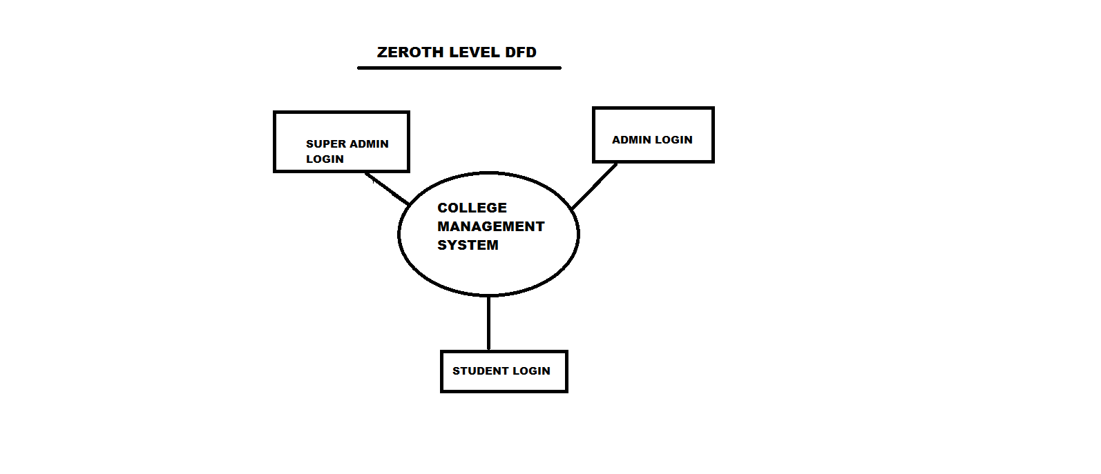

Slide 6
